Slide 1


Churn Rate & Customer Retention Information Deck
Brought to you by Lost in a Forest Analytics

Slide 2
Contents
Overview
Demographics of churners
  What do they look like in terms of gender, age, family makeup etc
  What products are they using?
Factors influencing churning
What can Swan Teleco do to retain customers?
  Incentives
  Customer Service

Slide 3
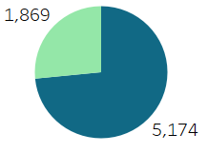
Overview
Total revenue: $16,056,169
Total Customers
Total customers: 7,043
Churners: 1,869
Non Churners: 5,174
Churned
Retained
Churn rate: 26.54%
Industry average Churn rate: 30-35% Source
  Significantly under current industry average

Slide 4
Demographics
The demographics of the people who churned in the dataset

Slide 5
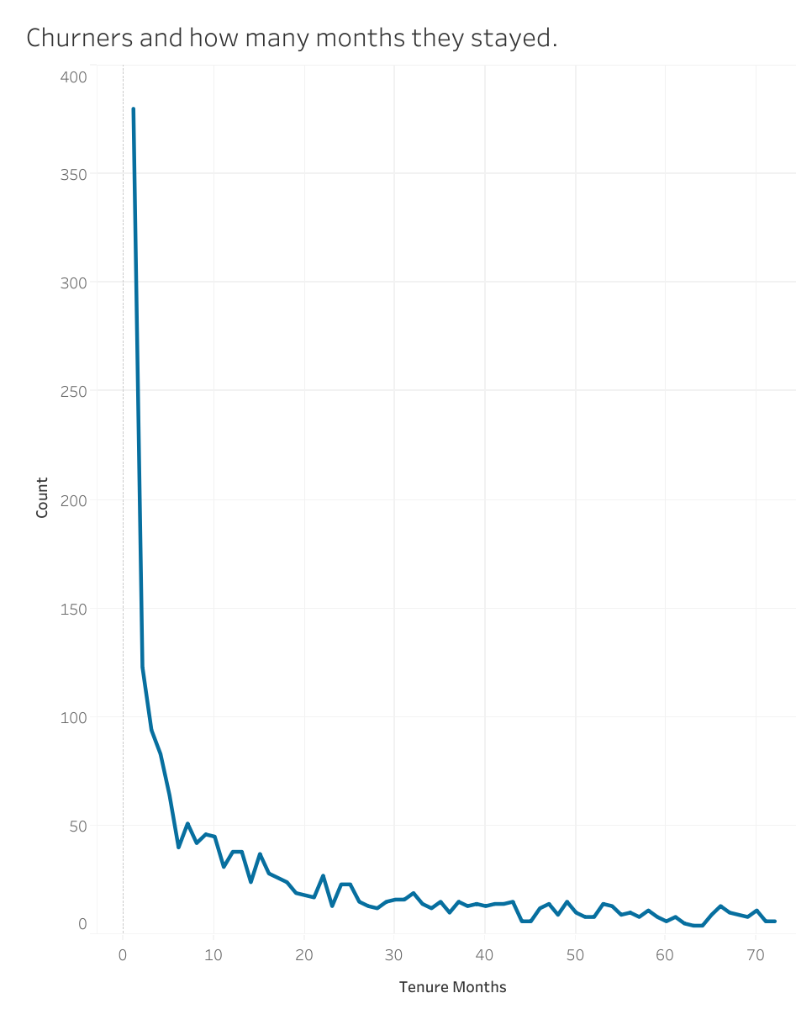
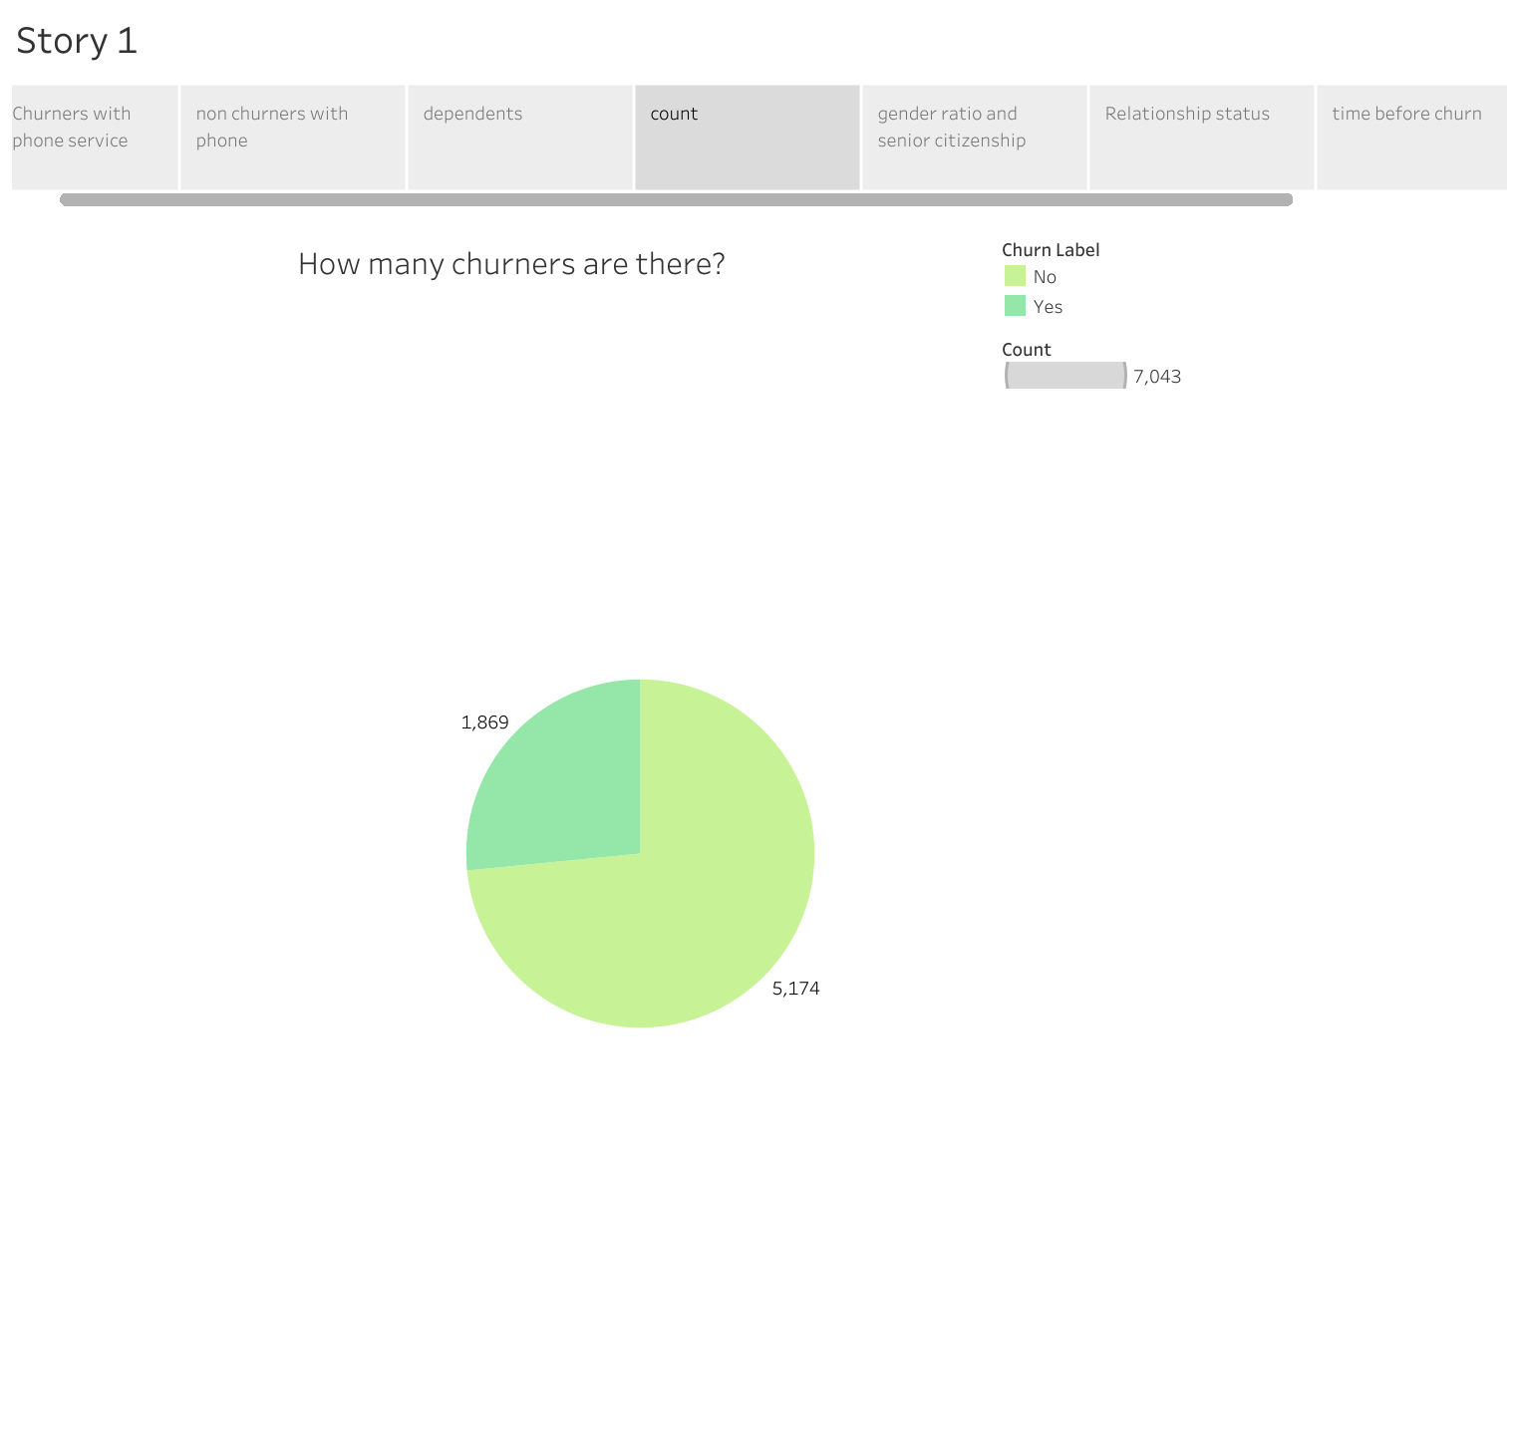
Long term customer retention is good.
The longer customers use Swan Teleco, the less likely they are to churn.
As mentioned in the introduction the churn rate is 26.54% which is below the average.

Slide 6
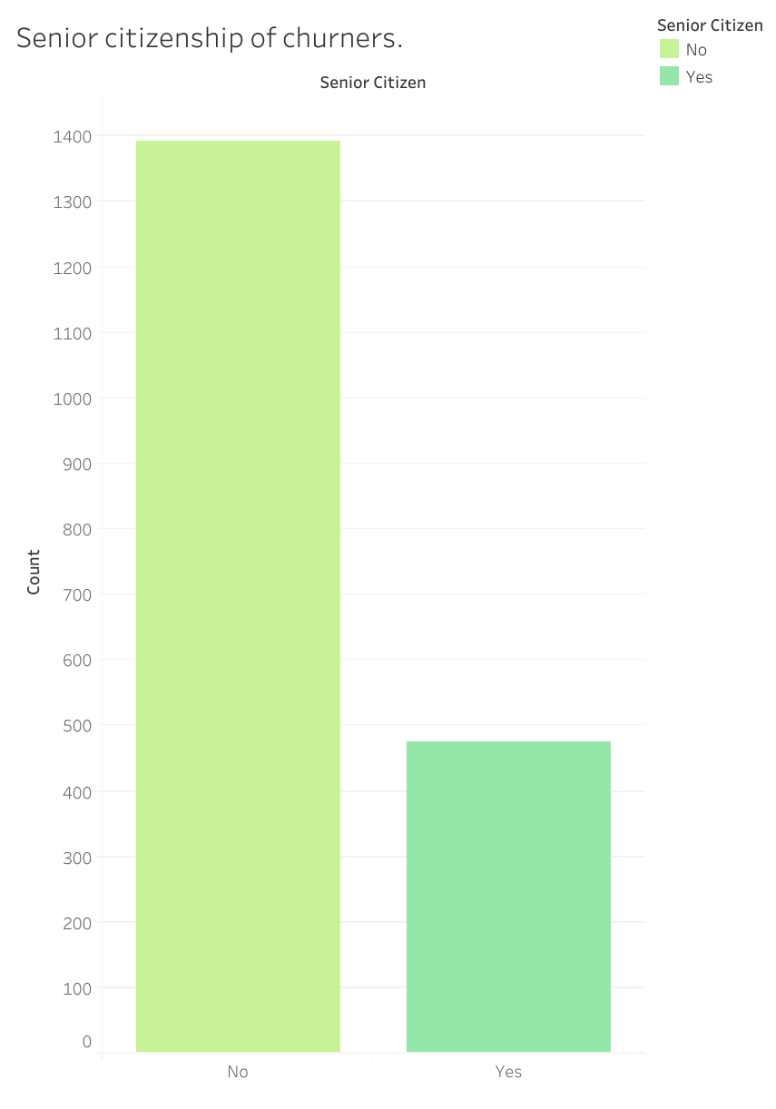
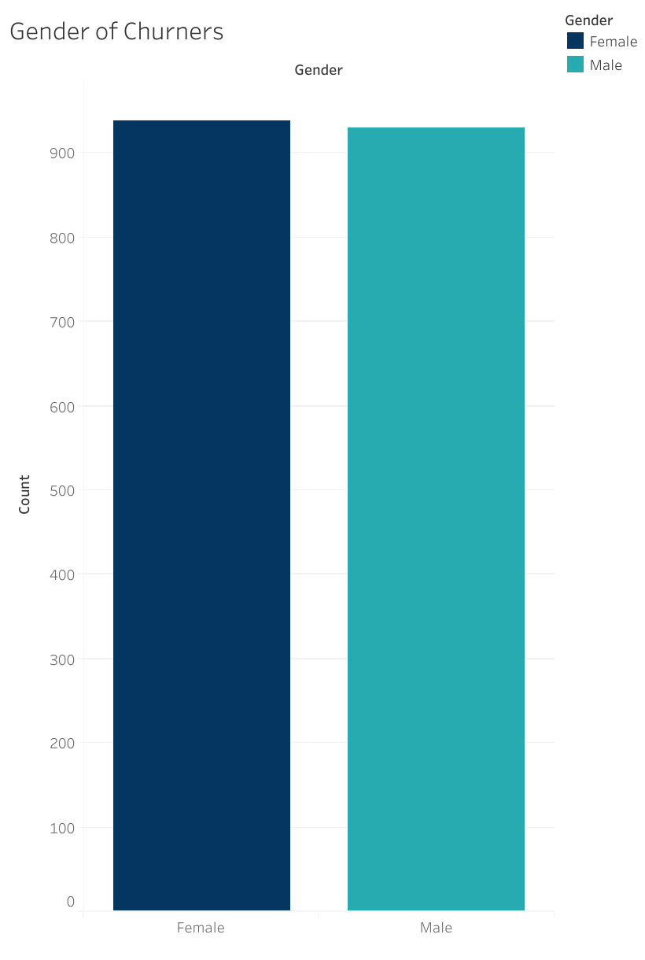
25.4% of churners were senior citizens.
According to the data, neither gender listed churned more than the other.

Slide 7
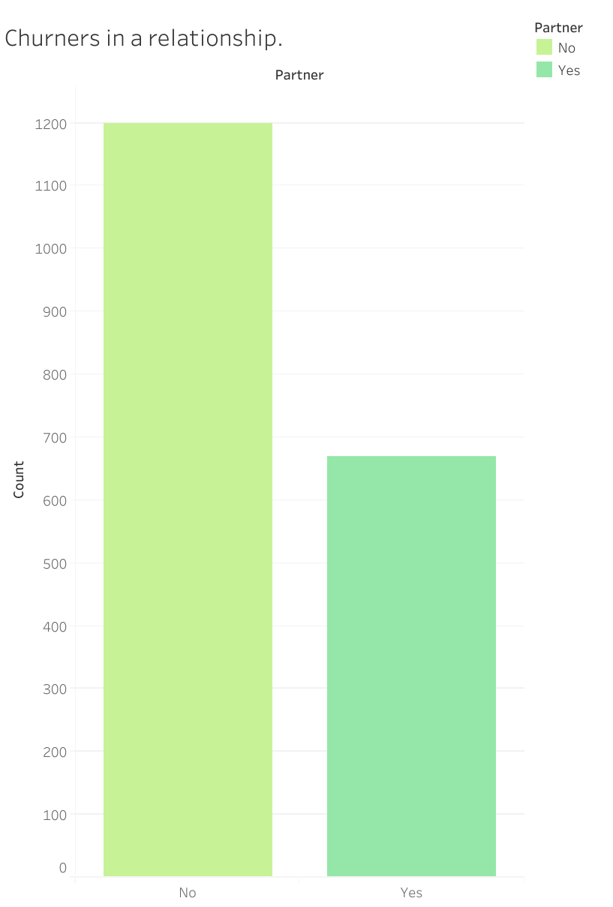
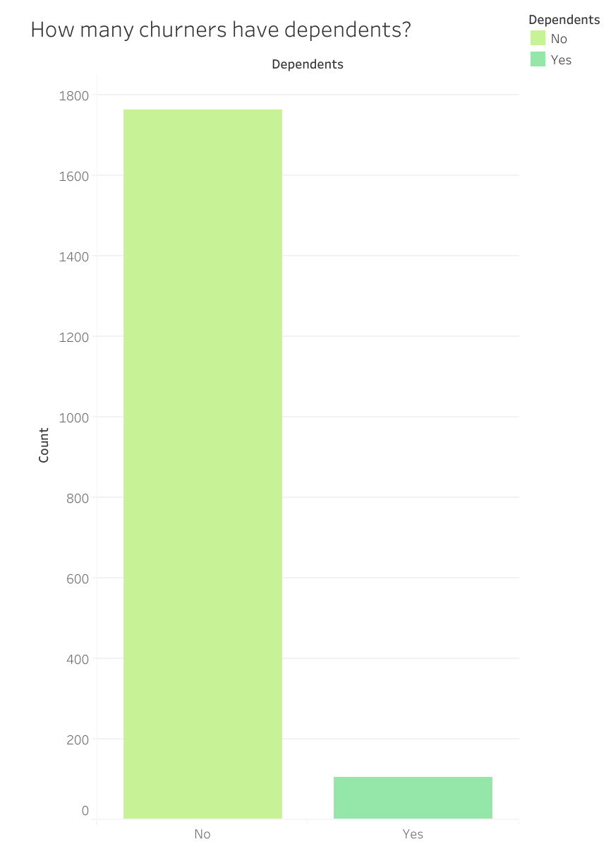
35.8% of churners are in a relationship.
0.06% of churners had dependents.

Slide 8
What products are being used?

Slide 9
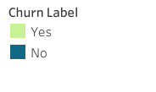
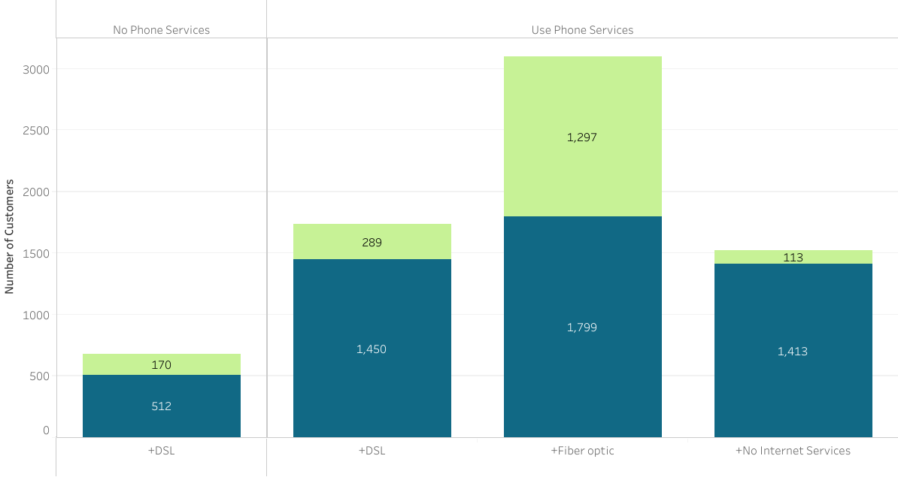
Basic Services Overview
Highlights:
Only 11 of the churning customers used all available services.
Fiber Optic users have the highest expectancy to churn with 42% having done so.

Slide 10
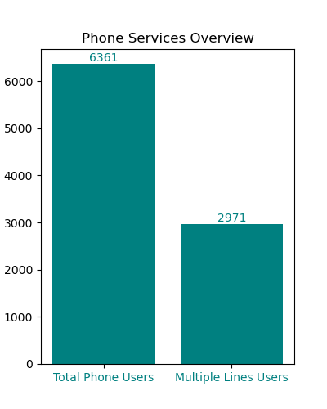
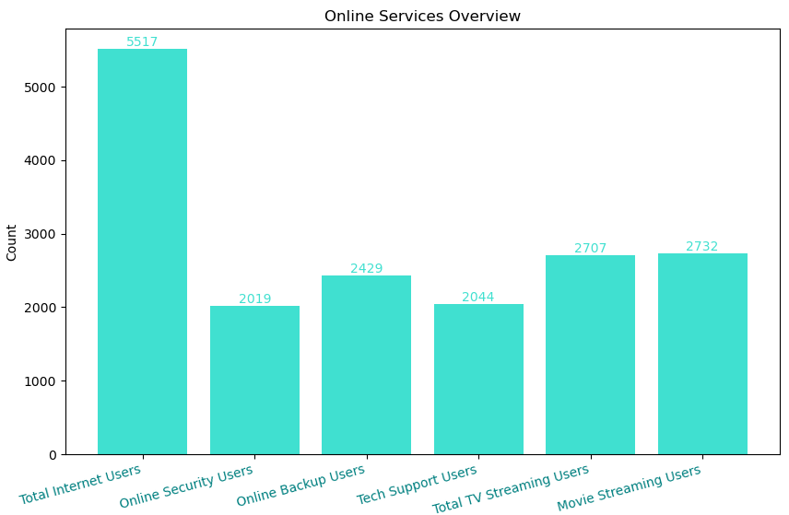
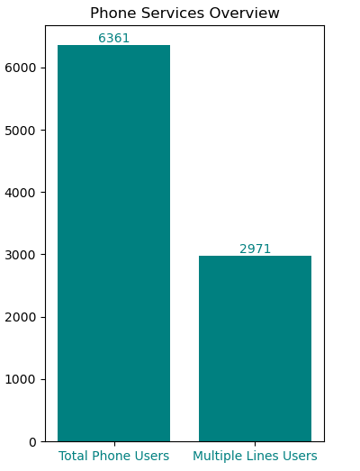
Specific Services overview

Slide 11
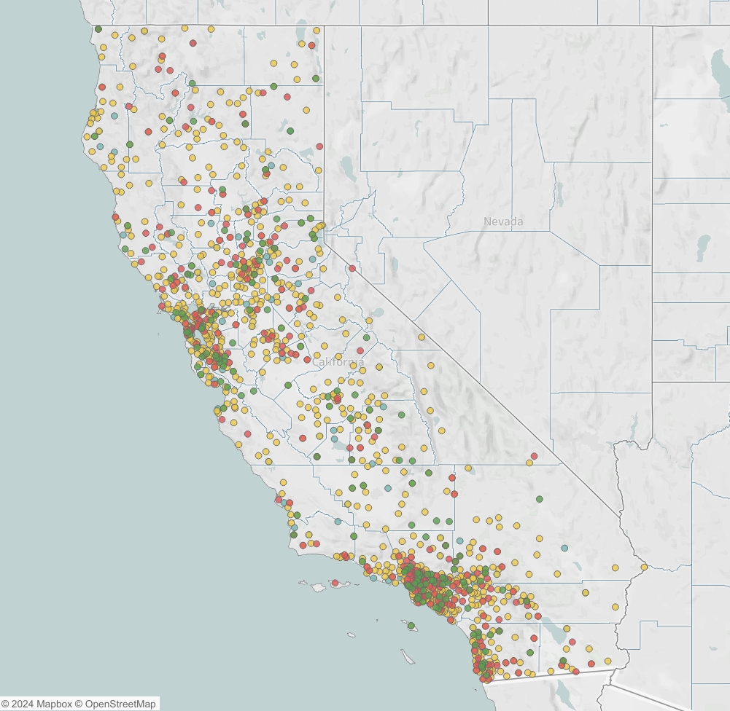
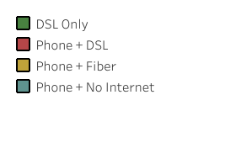
The distribution of churners based on the services they use does not indicate regional abnormalities.

Slide 12
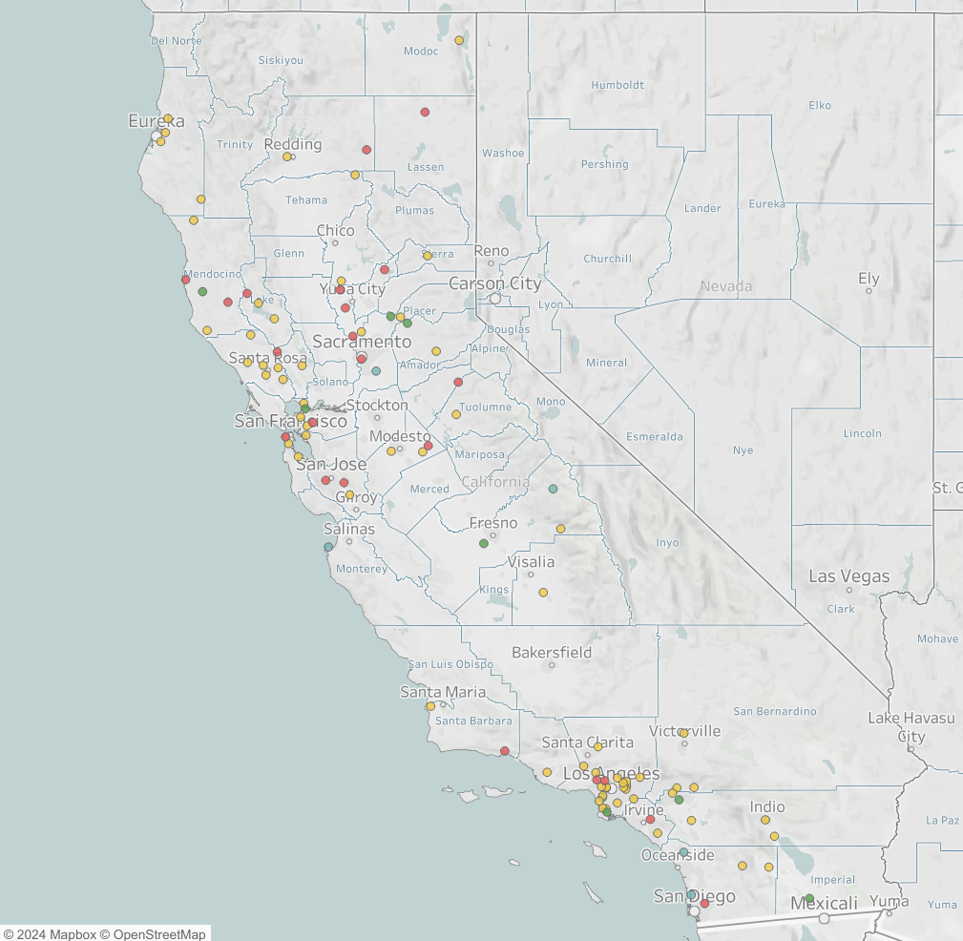
A geographical overview of the complains that report bad network.
The distribution does not indicate network problems to be a regional issue, therefore the reasons being local or isolated.

Slide 13
What factors are most influential on someone churning?

Slide 14
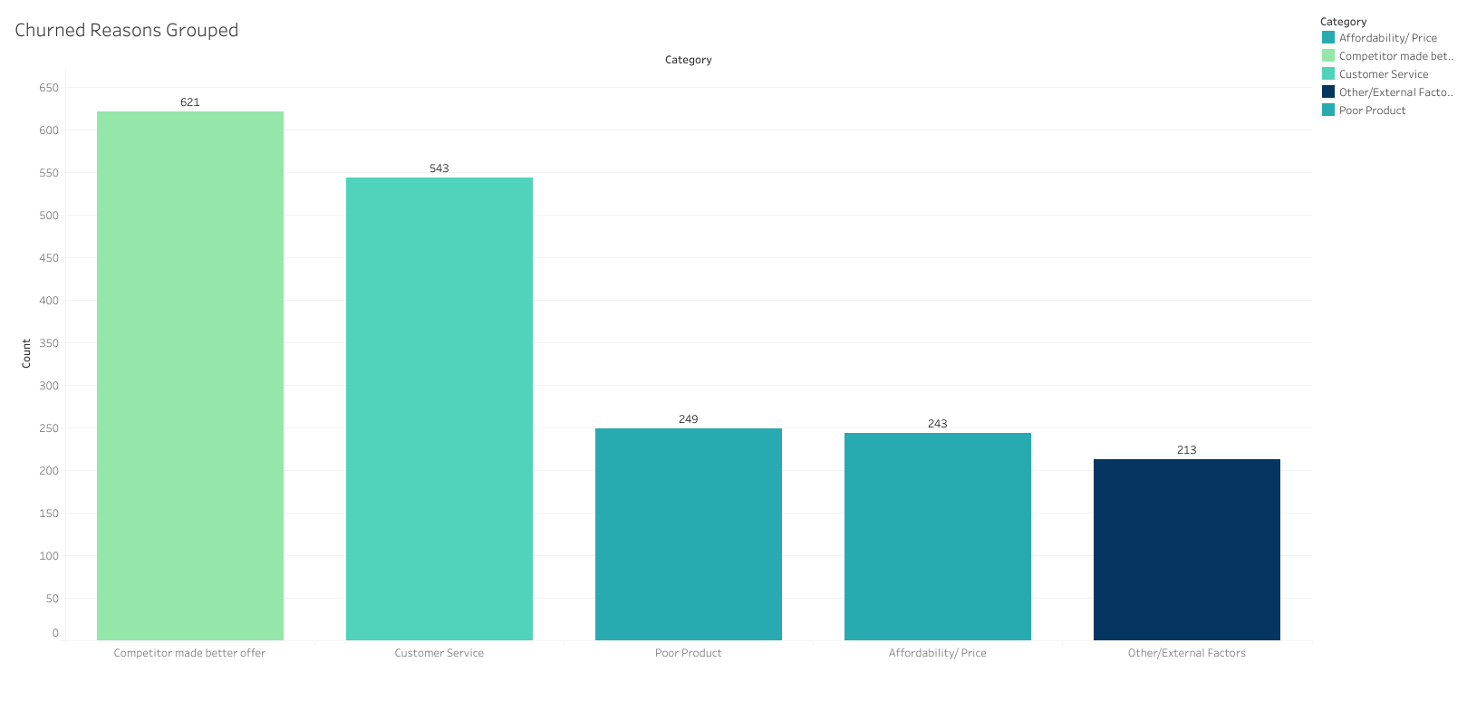
Competitor offers and customer service are the two significantly largest factors when it comes to churning.
They account for over half of all Churners alone.

Slide 15
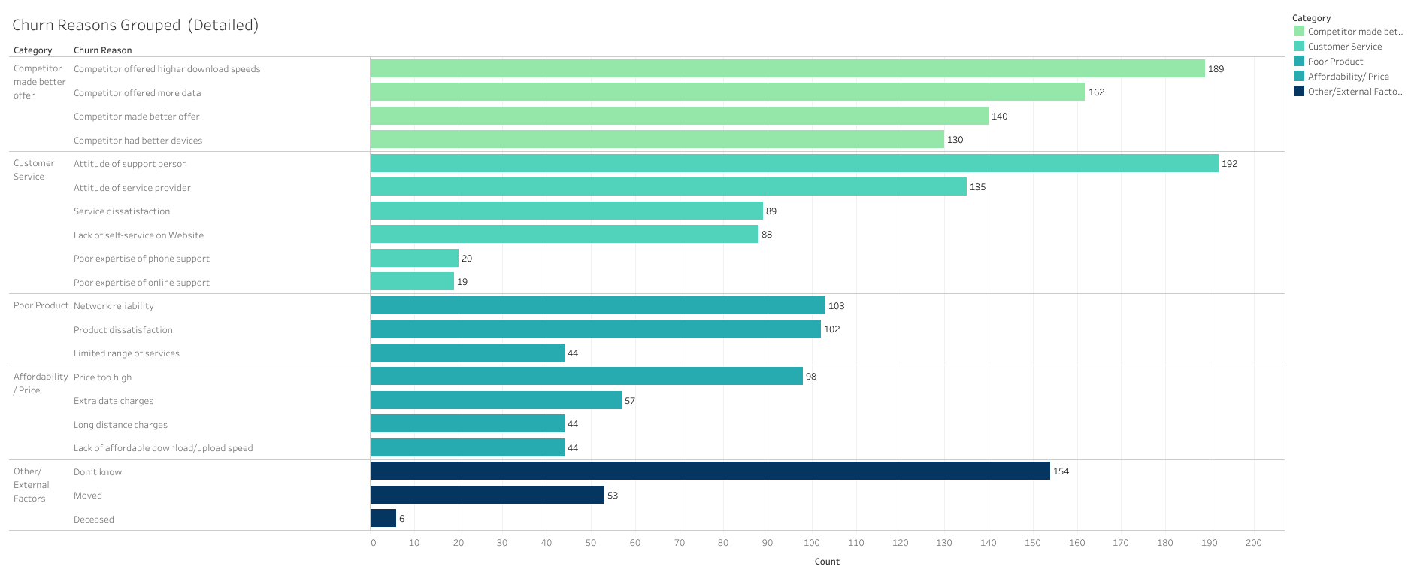
This Graph goes into further detail on how the churn reasons are grouped.
Within the Competitor category, quality of product offered by these competitors ranks highly, along with offers(price).

Slide 16
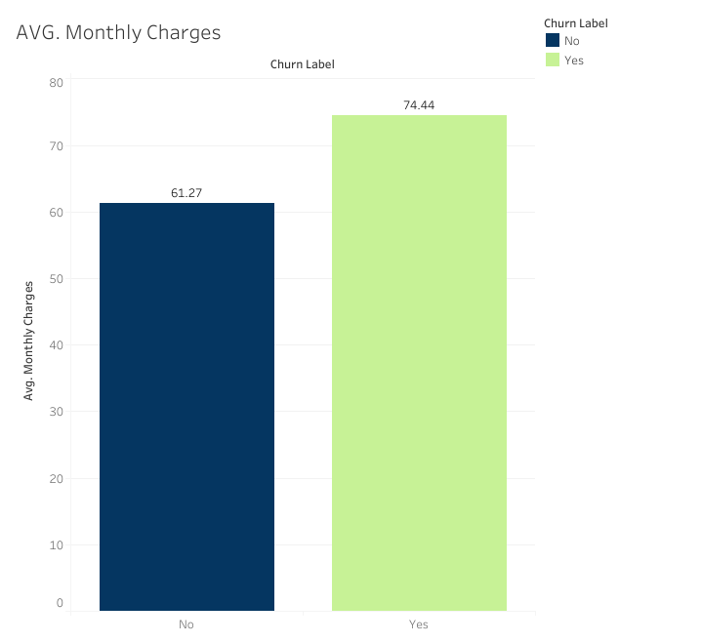
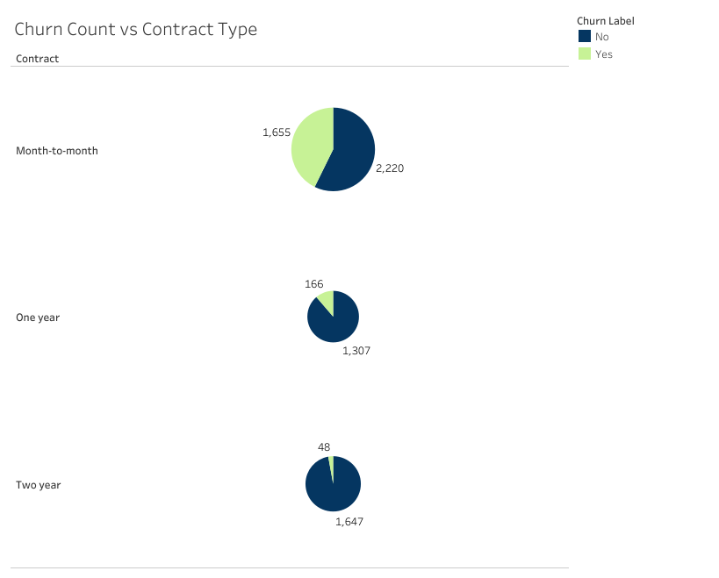
Contract type is a significant indicator on whether a customer churns.
The longer the contract the less likely a customer is to churn.
Average monthly charges were found to be significantly less in the case of retained customers, when compared with churners.

Slide 17
What can Swan Teleco do to retain customers?

Slide 18
What sign up factor should Swan Teleco incentivise?
Contract length
As mentioned in the previous slide, Contract length has a big impact on whether a customer is likely to churn or not:
  Two Year contract: 3% Churn rate
  One year contract: 11% Churn rate
  Monthly contract: 43% Churn rate
Long term customers tend to have slightly lower monthly costs.
It is our recommendation that Swan Teleco incentivise this further by offering sign up discounts to customers committing to longer contracts.

Slide 19
Customer Service
23% of churners leave Swan Teleco due to dissatisfaction with the customer service in one form or another.
This accounts for 8% of customers total.
Customers value their interactions with a service provider highly, with “86% of buyers willing to pay more for a great customer experience.” -PwC
We therefore urge Swan Teleco, to invest in its in house training and customer service systems in order to increase customer satisfaction, and subsequently customer retention.

